Slide 1
Temporal Difference Learning

Slide 2
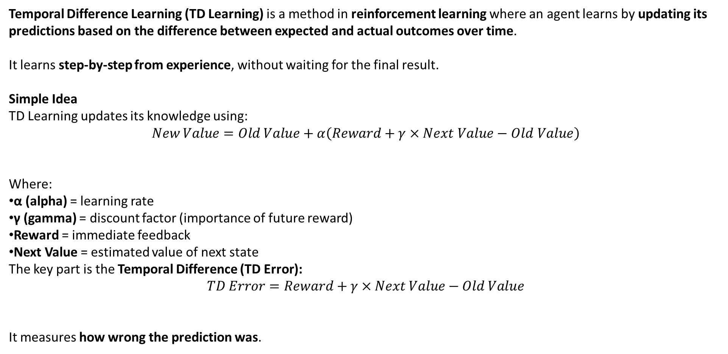
Temporal Difference Learning (TD Learning) is a method in reinforcement learning where an agent learns by updating its predictions based on the difference between expected and actual outcomes over time.
It learns step-by-step from experience, without waiting for the final result.
Simple Idea
TD Learning updates its knowledge using:
$$New Value=Old Value+α\left(Reward+γ×Next Value−Old Value\right)$$
Where:
α (alpha) = learning rate
γ (gamma) = discount factor (importance of future reward)
Reward = immediate feedback
Next Value = estimated value of next state
The key part is the Temporal Difference (TD Error):
$$TD Error=Reward+γ×Next Value−Old Value$$
It measures how wrong the prediction was.

Slide 3
Temporal Difference (TD) learning a model-free reinforcement learning technique that aims to align the expected prediction with the latest prediction, thus matching expectations with actual outcomes and progressively enhancing the accuracy of the overall prediction chain. It also seeks to predict a combination of the immediate reward and its own reward prediction at the same moment.
In temporal difference learning, the signal used for training a prediction comes from a future prediction. This approach is a combination of the Monte Carlo (MC) technique and the Dynamic Programming (DP) technique. Monte Carlo methods modify their estimates only after the final result is known, whereas temporal difference techniques adjust predictions to match later, more precise predictions for the future, well before knowing the final outcome. This is essentially a type of bootstrapping.

Slide 4
Real Life Examples of Temporal Difference Learning
1. Learning to Drive
Imagine a new driver learning how to drive.
Situation
You approach a speed breaker too fast.
The car bumps strongly (negative reward).
Learning Process
You adjust your speed earlier next time.
Your brain updates the expectation about road bumps.
TD Idea You don't wait until the entire trip ends; you learn immediately after each action.

Slide 5
2. Studying for Exams
Suppose you prepare for a test.
Step 1: You think 1 hour of study = good preparation.
Step 2: During a mock test, you perform poorly.
Step 3: You update your expectation: “Maybe I need 3 hours of study.”
You adjust continuously after each test, not only after the final exam.

Slide 6
Why Temporal Difference Learning is Powerful
Learns without full knowledge of environment
Updates predictions instantly
Works for continuous decision problems
Used in AI, robotics, finance, and gaming

Slide 7
Difference Between Temporal Difference Learning and Monte Carlo Method
Basis | Temporal Difference Learning (TD) | Monte Carlo Method (MC)
Learning Time | Learns after each step | Learns after the entire episode ends
Update Method | Uses current estimate + next state value | Uses actual final return
Need of Episode End | Not required | Required
Speed of Learning | Faster because updates occur continuously | Slower because it waits until the end
Variance | Lower variance | Higher variance
Bootstrapping | Uses bootstrapping (updates using estimated values) | No bootstrapping (uses real outcome)
Suitability | Works well for continuous tasks | Works best for episodic tasks
Example | Robot learning step-by-step while walking | Learning after finishing a complete game

Slide 8
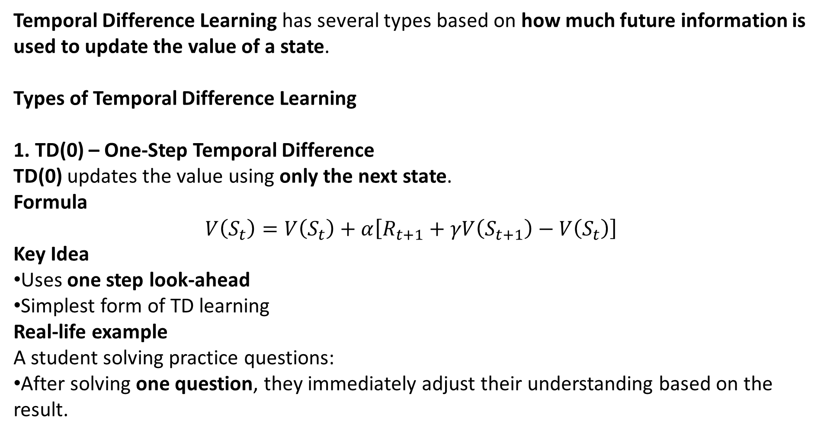
Temporal Difference Learning has several types based on how much future information is used to update the value of a state.
Types of Temporal Difference Learning
1. TD(0) – One-Step Temporal Difference
TD(0) updates the value using only the next state.
Formula
$$V\left(S_{t}\right)=V\left(S_{t}\right)+α\left[R_{t+1}+γV\left(S_{t+1}\right)−V\left(S_{t}\right)\right]$$
Key Idea
Uses one step look-ahead
Simplest form of TD learning
Real-life example A student solving practice questions:
After solving one question, they immediately adjust their understanding based on the result.

Slide 9
Symbol | Meaning
V(St) | Value of current state
α (alpha) | Learning rate
R(t+1) | Reward received after action
γ (gamma) | Discount factor for future reward
V(S(t+1)) | Value of next state

Slide 10
Real Life Example
Example: Learning to Drive
Suppose a learner driver estimates:
Smooth driving on a road = value 5
While driving:
Driver goes too fast on a turn.
Car skids slightly (negative reward).
Driver updates expectation immediately.
Next time:
Driver slows down earlier.
This is TD(0) because learning happens after one step experience.

Slide 11
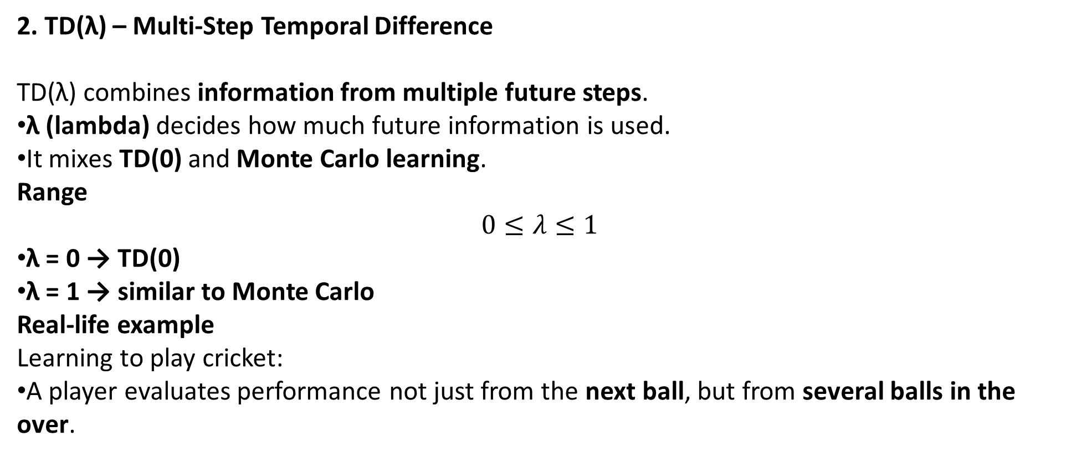
2. TD(λ) – Multi-Step Temporal Difference
TD(λ) combines information from multiple future steps.
λ (lambda) decides how much future information is used.
It mixes TD(0) and Monte Carlo learning.
Range
$$0≤λ≤1$$
λ = 0 → TD(0)
λ = 1 → similar to Monte Carlo
Real-life example Learning to play cricket:
A player evaluates performance not just from the next ball, but from several balls in the over.

Slide 12
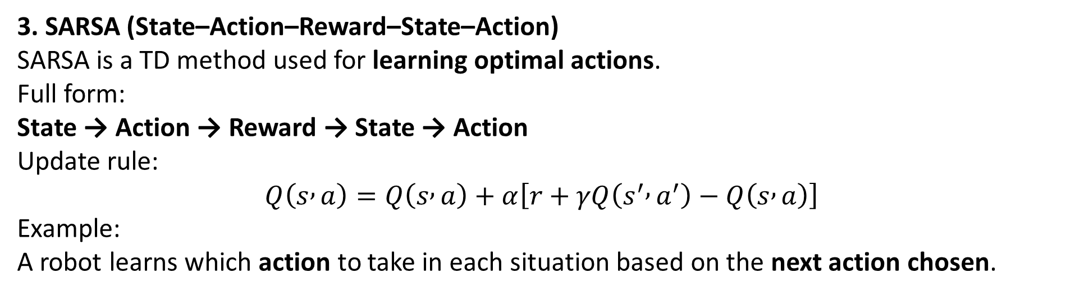
3. SARSA (State–Action–Reward–State–Action)
SARSA is a TD method used for learning optimal actions.
Full form: State → Action → Reward → State → Action
Update rule:
$$Q\left(s , a\right)=Q\left(s , a\right)+α\left[r+γQ\left(s^{′} , a^{′}\right)−Q\left(s , a\right)\right]$$
Example: A robot learns which action to take in each situation based on the next action chosen.

Slide 13
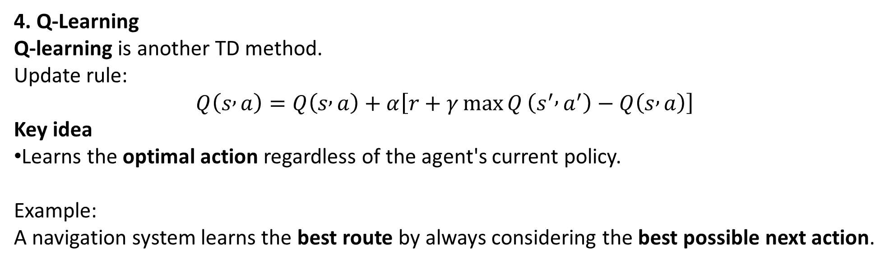
4. Q-Learning
Q-learning is another TD method.
Update rule:
$$Q\left(s , a\right)=Q\left(s , a\right)+α\left[r+γ\max{Q}\left(s^{′} , a^{′}\right)−Q\left(s , a\right)\right]$$
Key idea
Learns the optimal action regardless of the agent's current policy.
Example: A navigation system learns the best route by always considering the best possible next action.

